Slide 1
Multi-class Cyberbullying Tweet Classification

Slide 2
Overview
Introduction
Data cleaning
Exploratory Data Analysis
Modelling
Conclusion

Slide 3
Introduction
Cyberbullying is a threat to modern society
Kaggle dataset
47000 tweets labelled
Age
Ethnicity
Gender
Religion
Other type of cyberbullying
Not cyberbullying

Slide 4
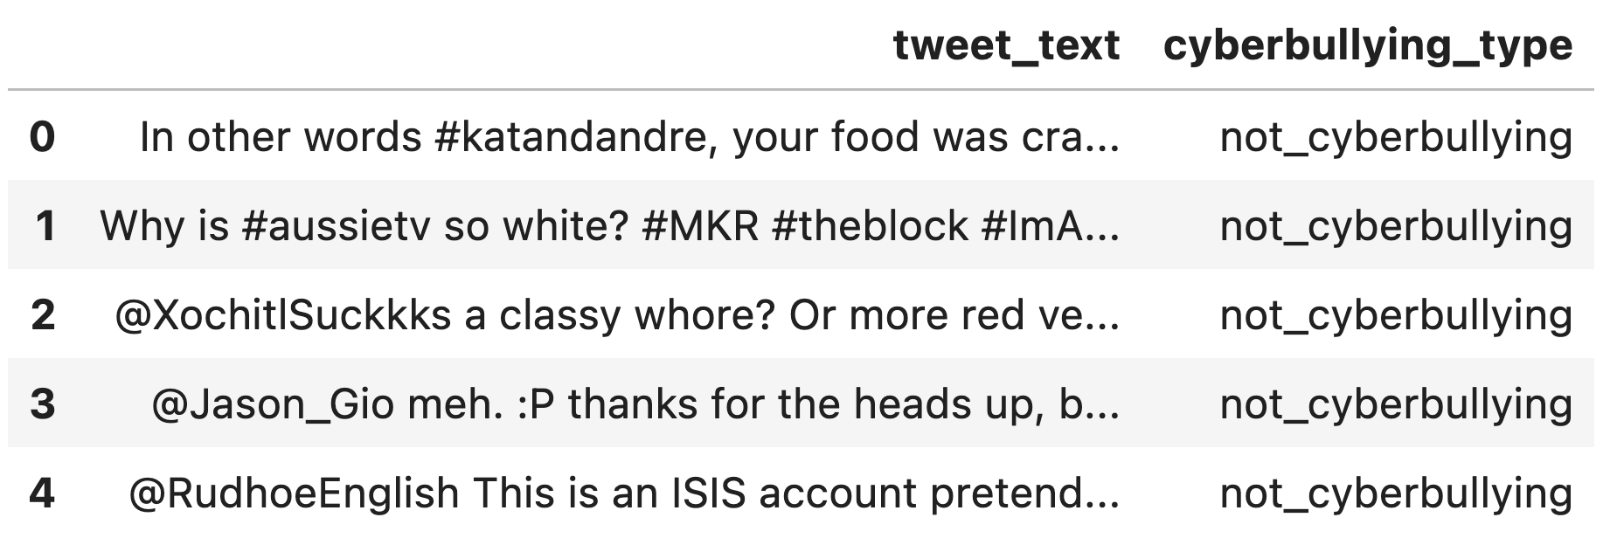
Data cleaning
Duplicate rows
Duplicate tweets
Missing data

Slide 5
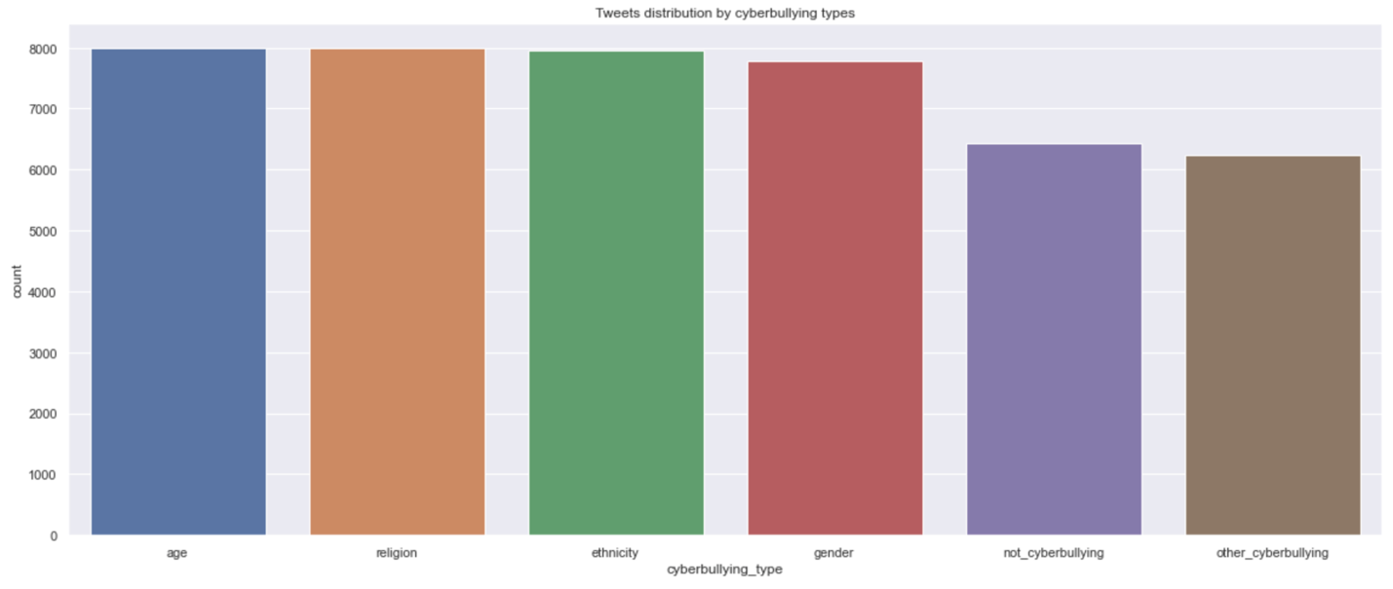
Exploratory Data Analysis

Slide 6
Exploratory Data Analysis
Removing punctuations, special characters, URLs & hashtags
Removing leading, trailing & extra white spaces/tabs
Typos, slangs are corrected, abbreviations are written in their long forms
Stop words which are generic such as ‘i’,’you’,’a’,’the’,’he’,’which’ etc
Stemming
Lemmatization

Slide 7
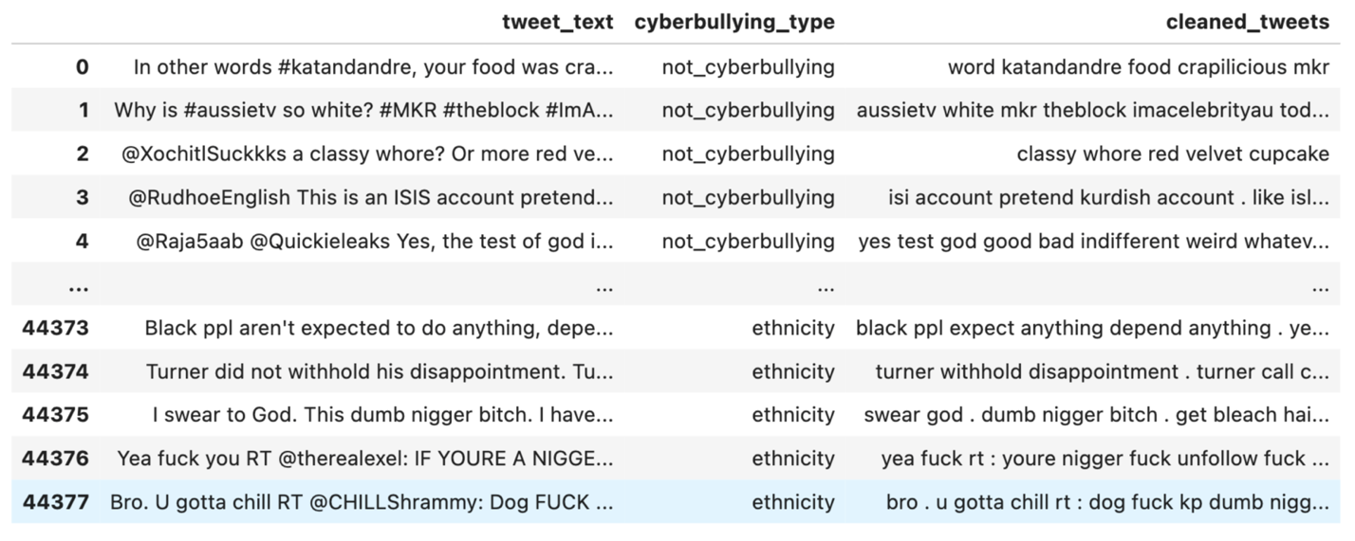
Exploratory Data Analysis

Slide 8
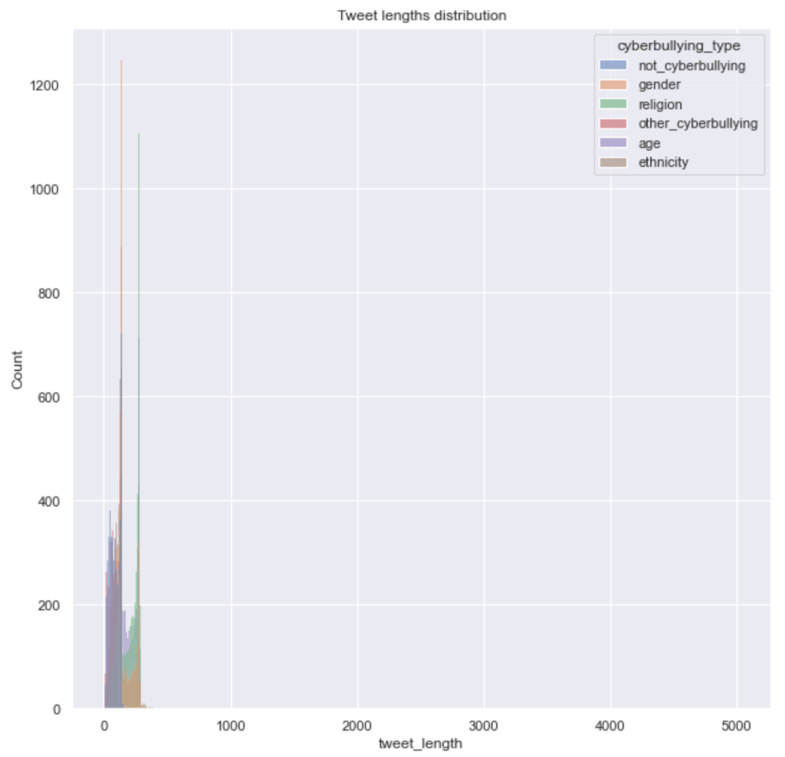
Exploratory Data Analysis

Slide 9
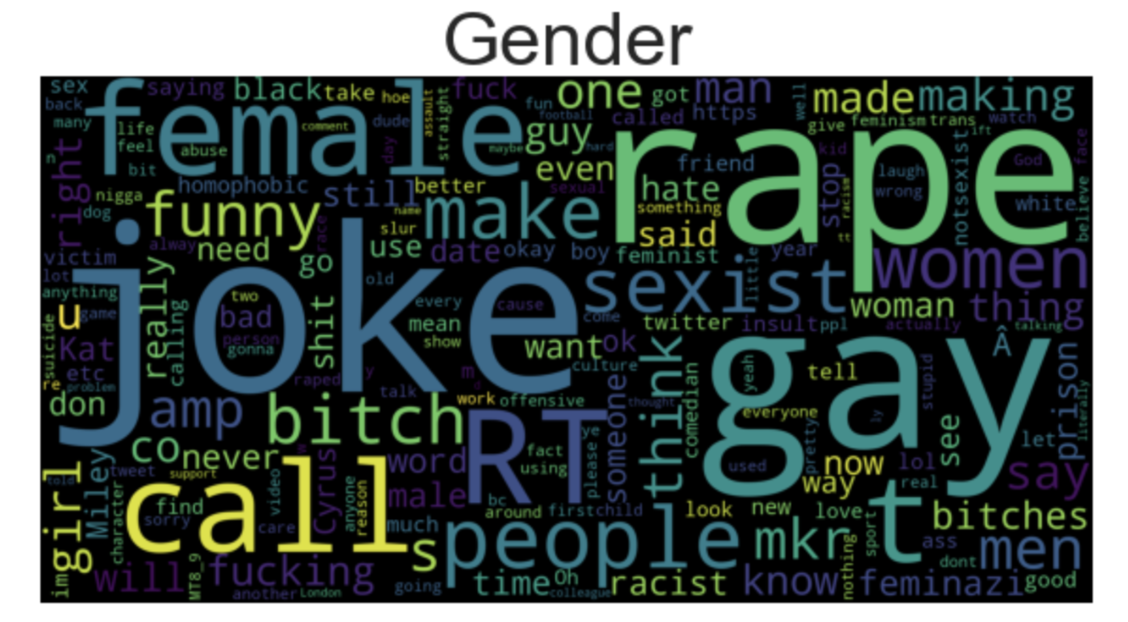
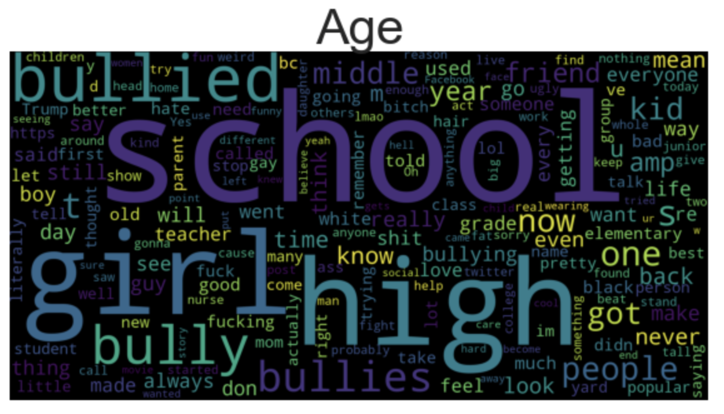
Exploratory Data Analysis

Slide 10
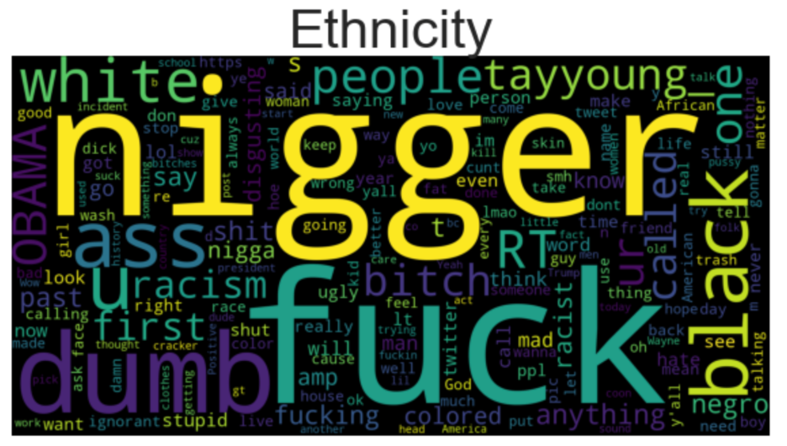
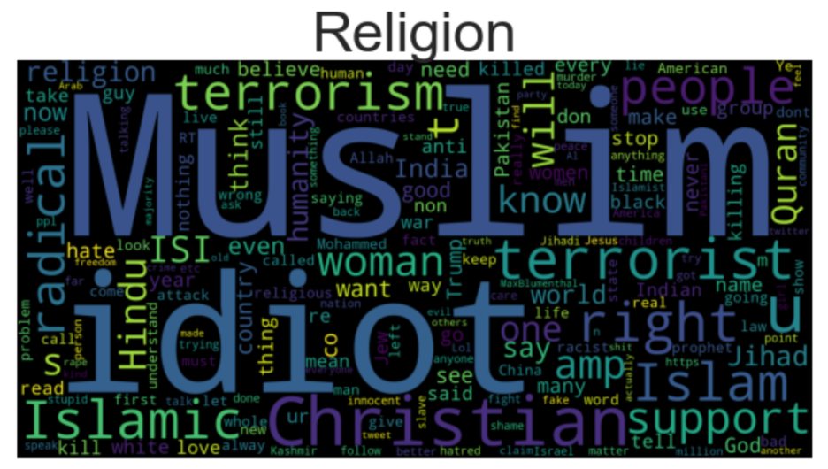
Exploratory Data Analysis

Slide 11
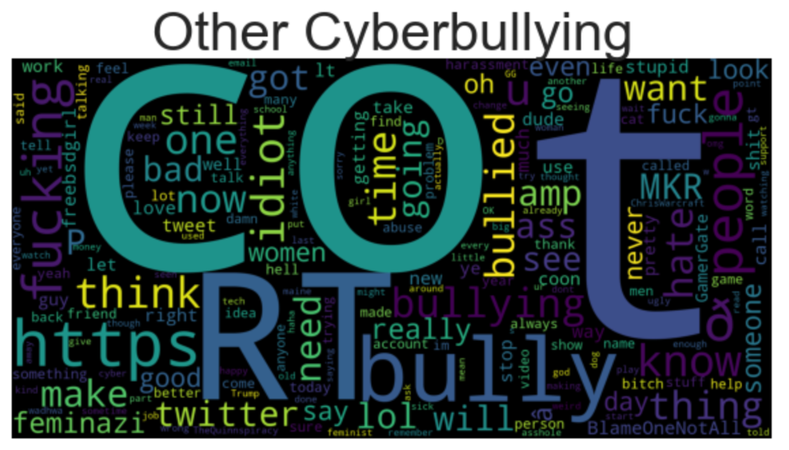
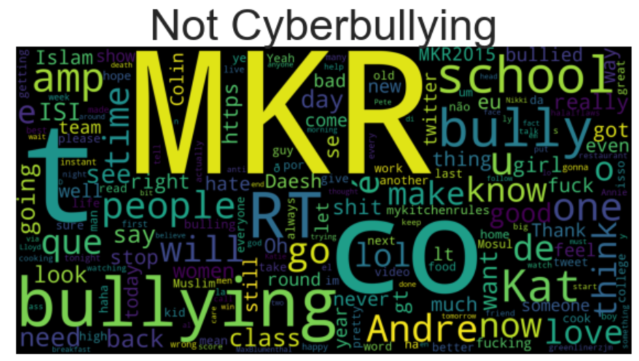
Exploratory Data Analysis

Slide 12
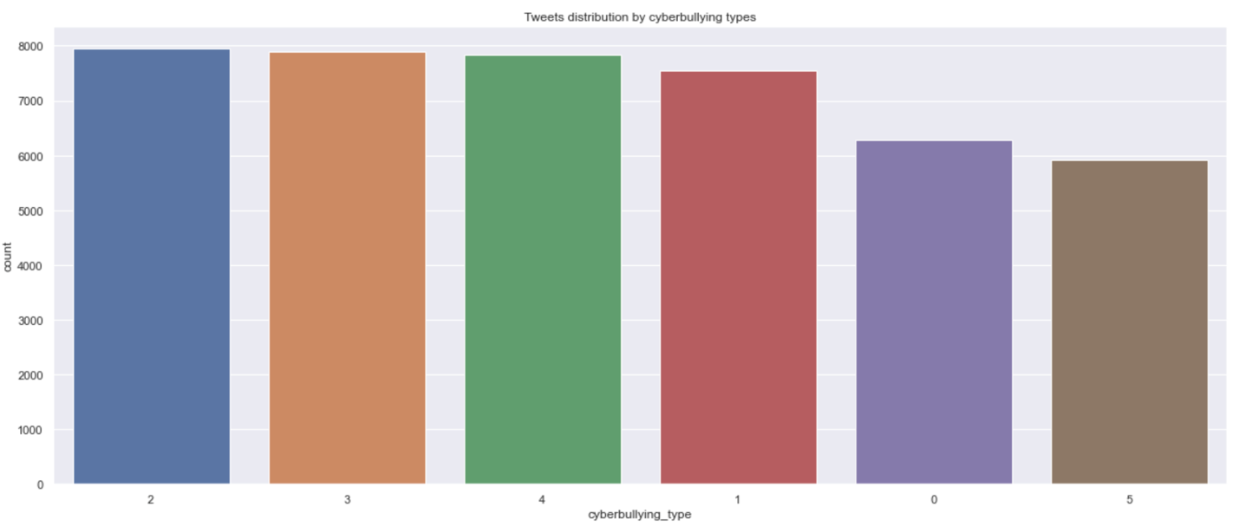
Preprocessing and Modeling
Term frequency–inverse document frequency (or Tf-Idf)
5000 features
N_gram = 1-3

Slide 13
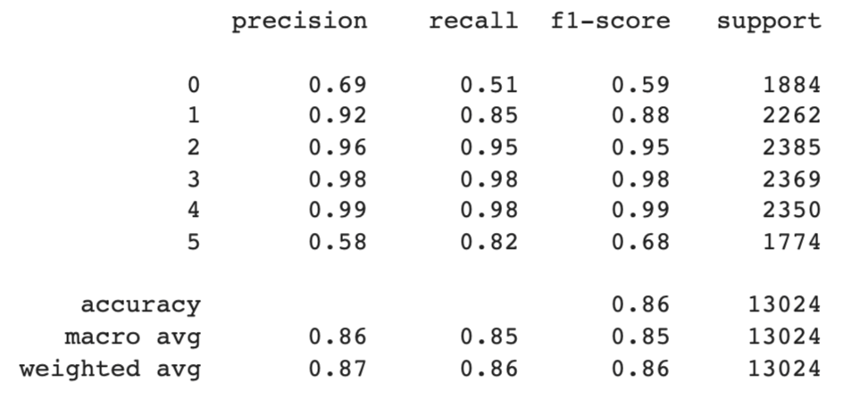
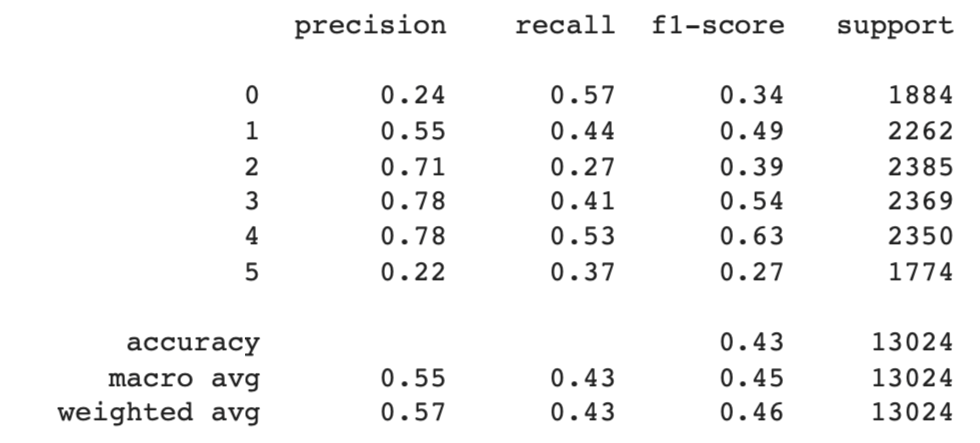
Modeling
XGBoost
KNN

Slide 14
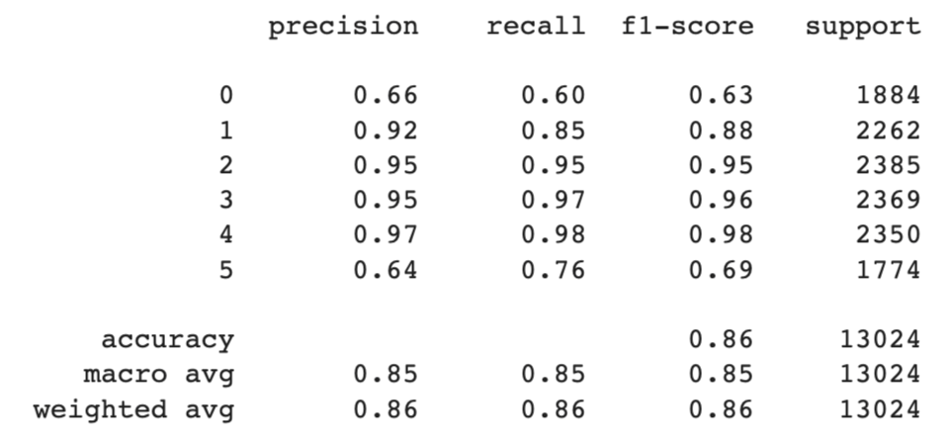
Modeling
Logistic regression
Comparison

Slide 15
Conclusion
Multi-class tweet classification model
Tf-idf as word embedding
Metrics such as F1 score, auc-roc and accuracy
XGBoost as Flask API

